Slide 1



Alain & Bernadette
Alice & Bob challenge
Joan Caceres, Théo Mahieu, Nicolas Schmid, Alban Leschallier de Lisle
11/05/2025

Slide 2
1.A. How to create a cat state?
$$\frac{dρ}{dt}=L(ρ)=-i[H,ρ]+κ_{b}D[\overset{̂}{b}](ρ)$$
$$H=g_{2}^{*}a^{†2}b+g_{2}a^{2}b^{†}+ϵ_{b}^{*}b+ϵ_{b}b^{†}$$
$$D[b](ρ)=bρb^{†}-\frac{1}{2}\left(b^{†}bρ+ρb^{†}b\right)$$

Slide 3
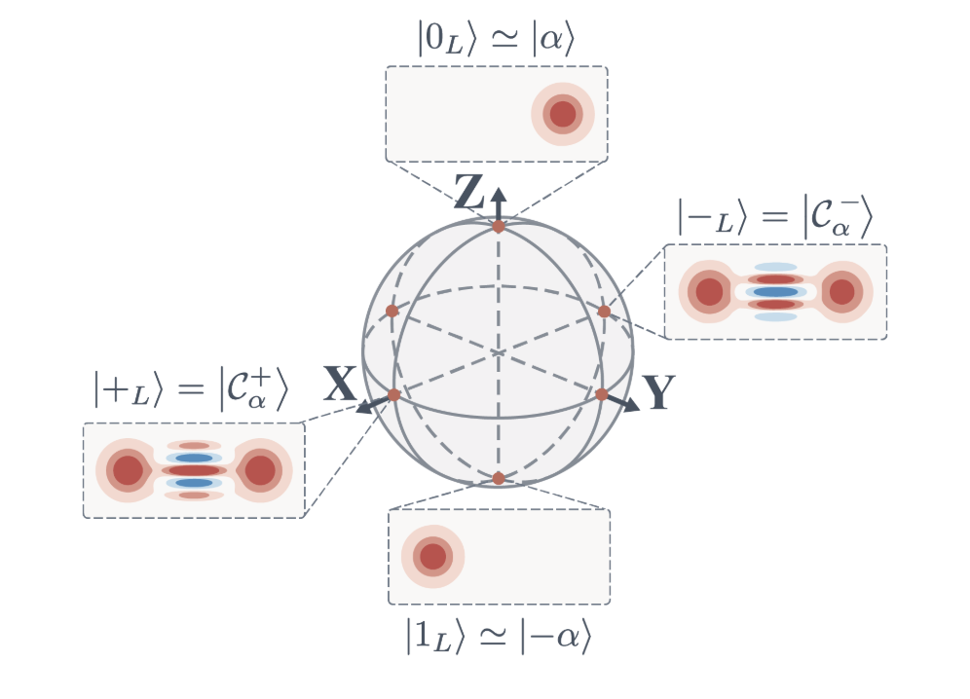
Bonus
Phase-space qubit equivalence

Slide 4
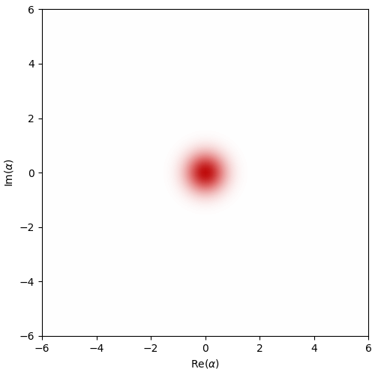
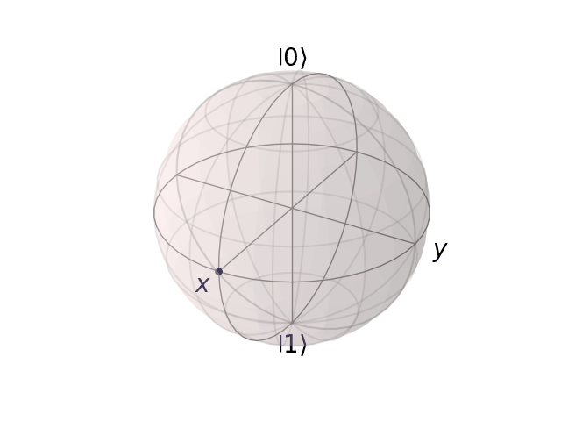

Slide 5
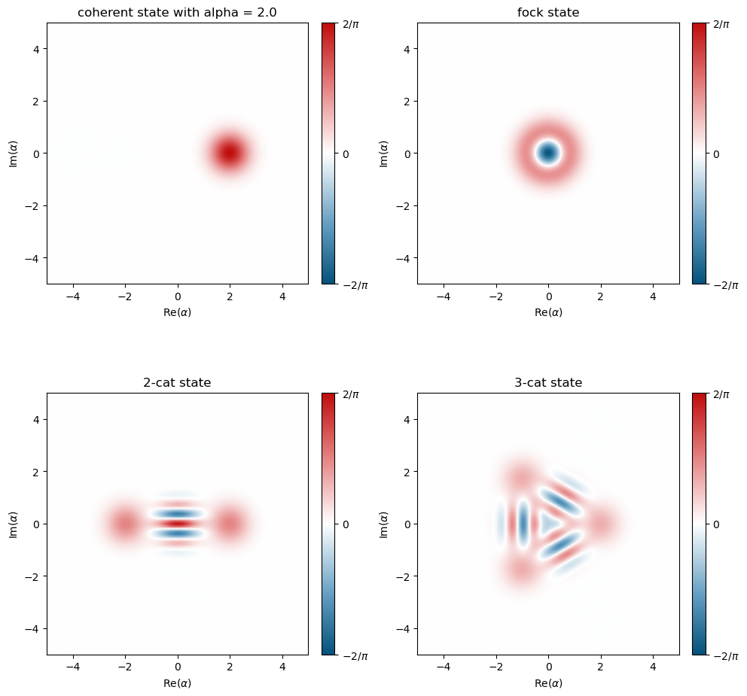
1.A. Generating Wigner Functions
1.A.1. Static Wigner function plots

Slide 6
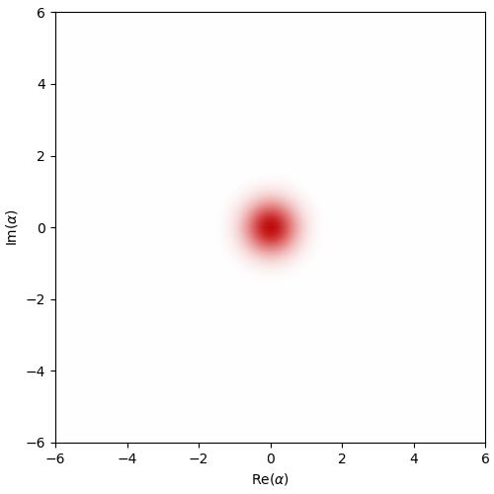
1.A. Generating Wigner Functions
1.A.2 Dissipative cat state’s Wigner function

Slide 7
1.B. Density Matrix Reconstruction from Wigner Data
1.A.1. Static Wigner function plots

Slide 8
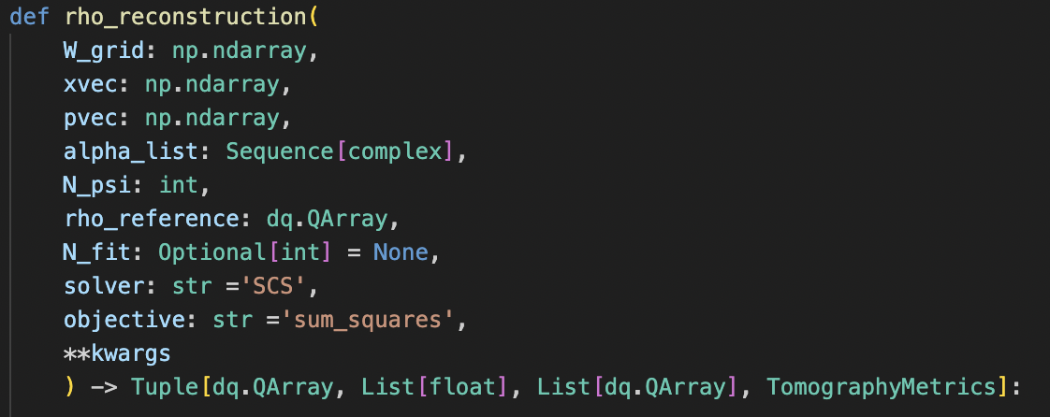
1.B. Density Matrix Reconstruction from Wigner Data
1.B.1. rho_reconstruction method
Validate shape of xvec, pvec and W_grid.
Make a wigner interpolation in the range of xvec and pvec.
Calculate $w_{k}$ from alpha_list.
Calculate $E_{α}$ from alpha_list.
Define $ρ_{obj}$ with constrains (cvxpy).
Calculate $p=Tr(E_{α}ρ_{obj})$
Minimize using ‘objective’ $dist(p-w_{k})$.
Get metrics (fidelity, trace distance, etc.)

Slide 9
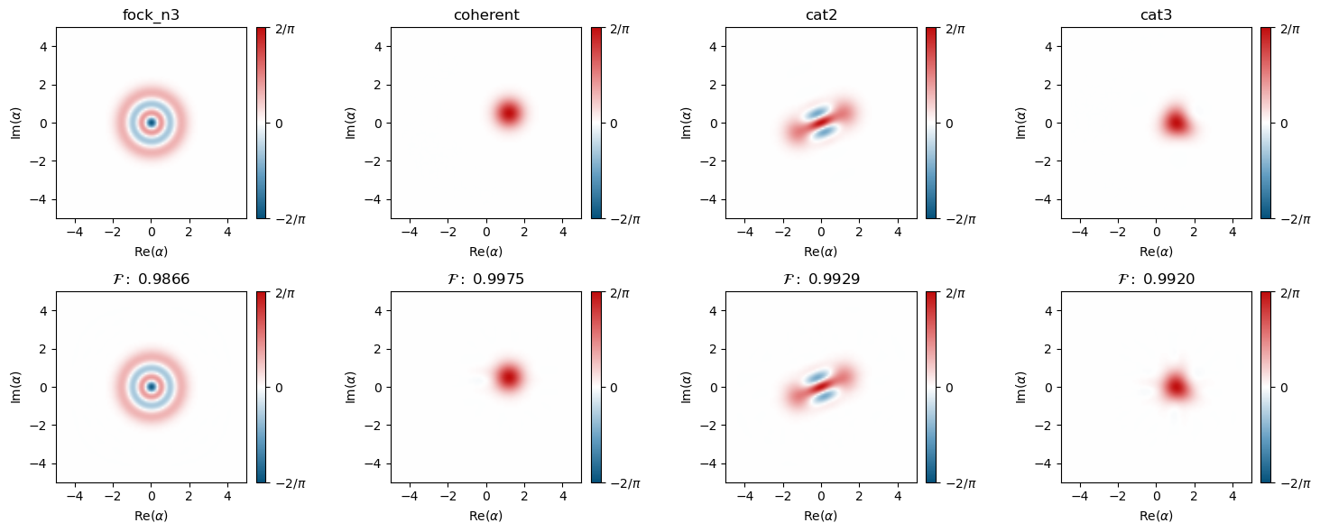
1.B. Density Matrix Reconstruction from Wigner Data
1.B.2-3. Synthetic data
N = 30
N fit = 100
$α$ points: 200 x 200
0.013727
0.022967
0.012412
0.033844
Trace distances

Slide 10
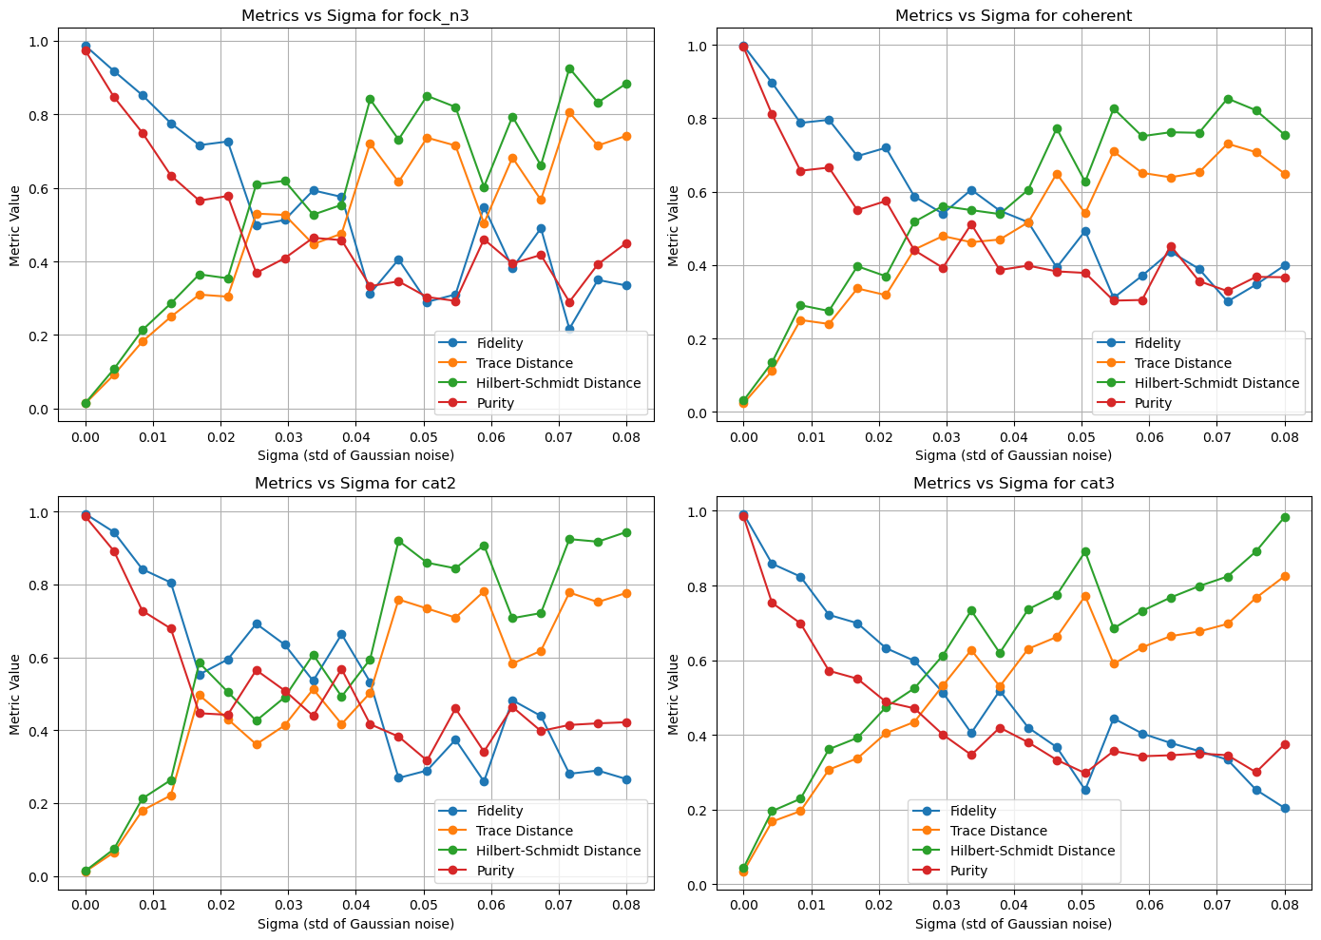
1.C. Robustness of the fit
1.C.1. Gaussian noise

Slide 11
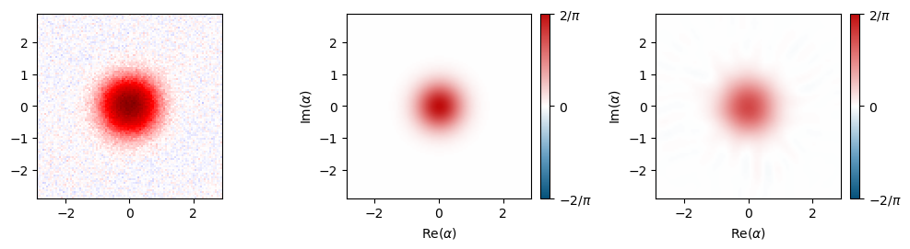
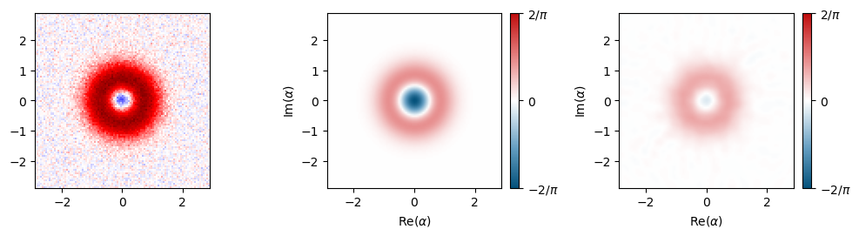
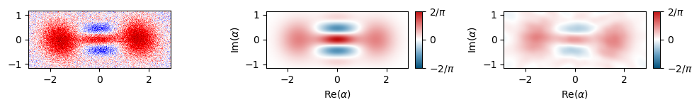
1.C. Robustness of the fit
Experimental data
Wigner reference
Wigner reconstruction
$$|0⟩$$
$$|1⟩$$
$$|\sqrt{2.5}⟩$$

Slide 12
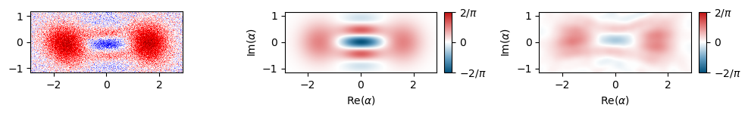
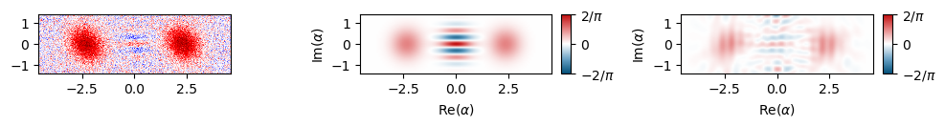
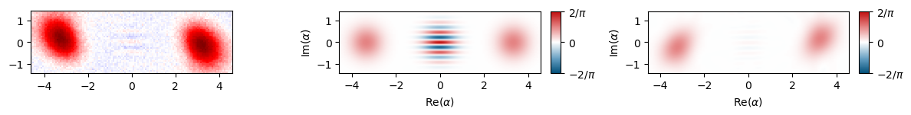
1.C. Robustness of the fit
Experimental data
Wigner reference
Wigner reconstruction
$$|-\sqrt{2.5}⟩$$
$$|\sqrt{5.6}⟩$$
$$|\sqrt{11.3}⟩$$

Slide 13
1.C. Robustness of the fit
Fidelity
Trace distance
Purity
$$|0⟩$$
0.868
0.868
0.770
$$|1⟩$$
0.519
0.482
0.438
$$|\sqrt{2.5}⟩$$
0.679
0.352
0.568
$$|-\sqrt{2.5}⟩$$
0.609
0.422
0.532
$$|\sqrt{5.6}⟩$$
0.525
0.556
0.533
$$|\sqrt{11.3}⟩$$
0.487
0.540
0.500

Slide 14
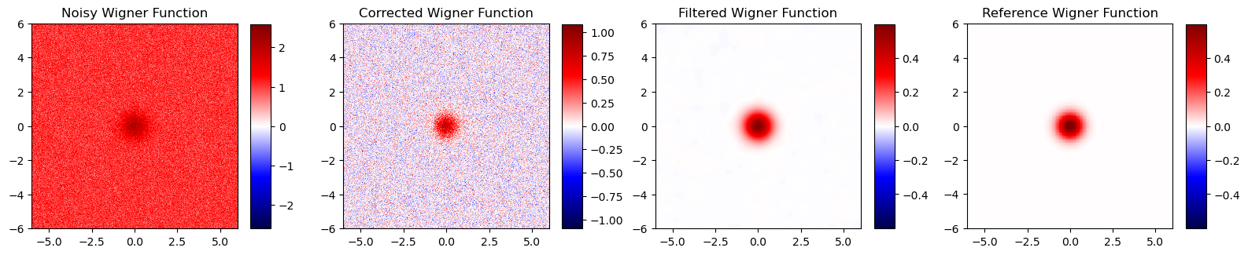
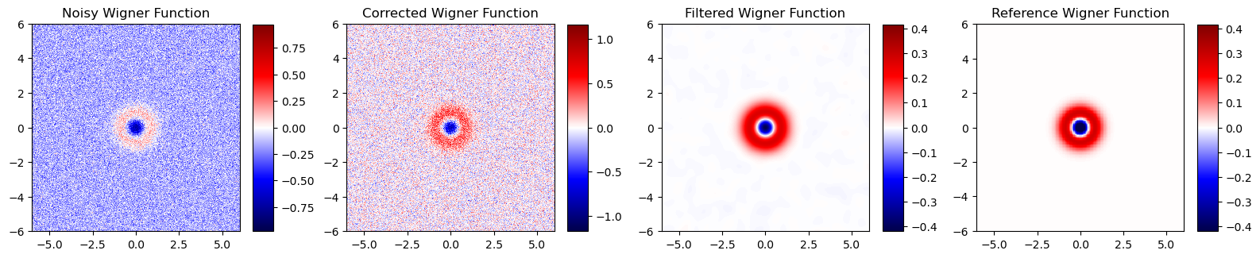
2. Denoising
2.A. Correcting Affine Distortions and Background Noise

Slide 15
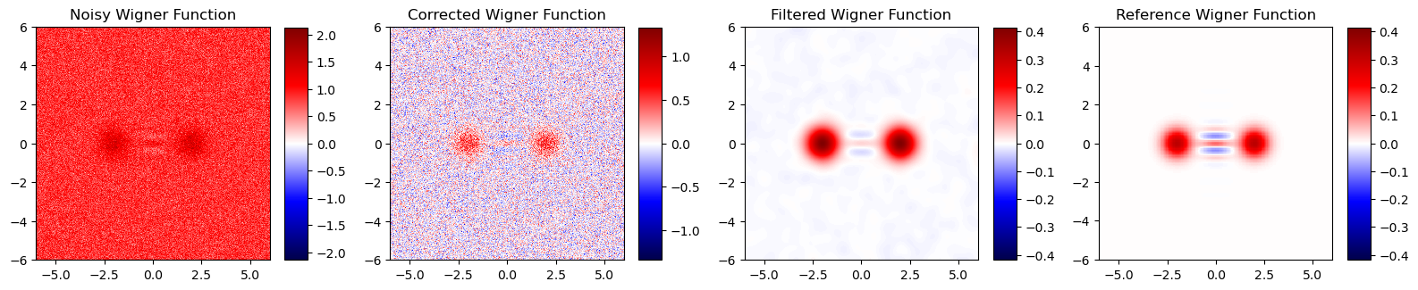
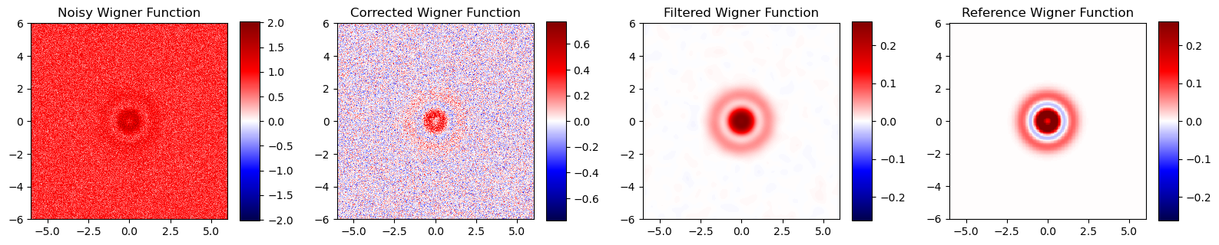
2. Denoising
2.A. Correcting Affine Distortions and Background Noise

Slide 16
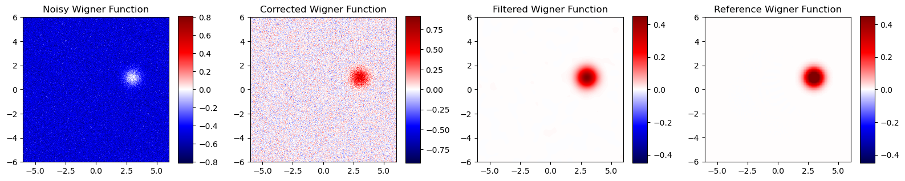
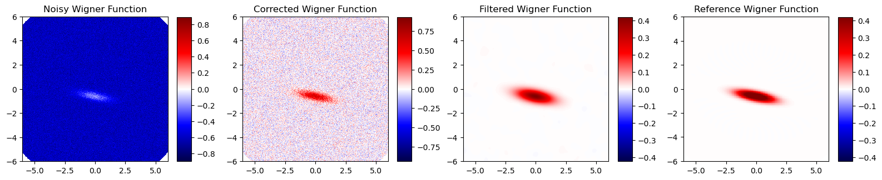
2. Denoising
2.A. Correcting Affine Distortions and Background Noise

Slide 17
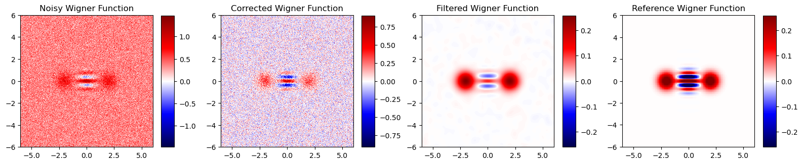
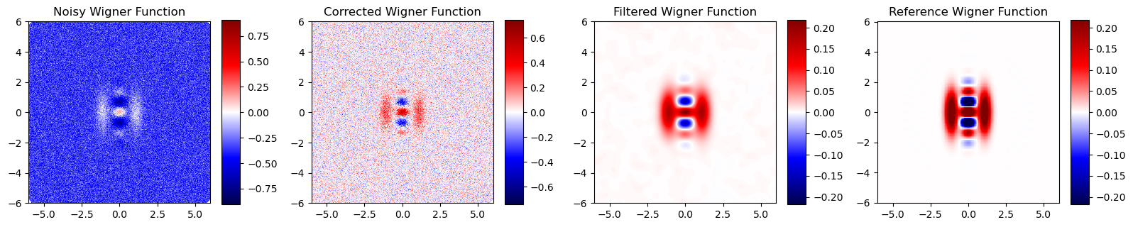
2. Denoising
2.A. Correcting Affine Distortions and Background Noise

Slide 18
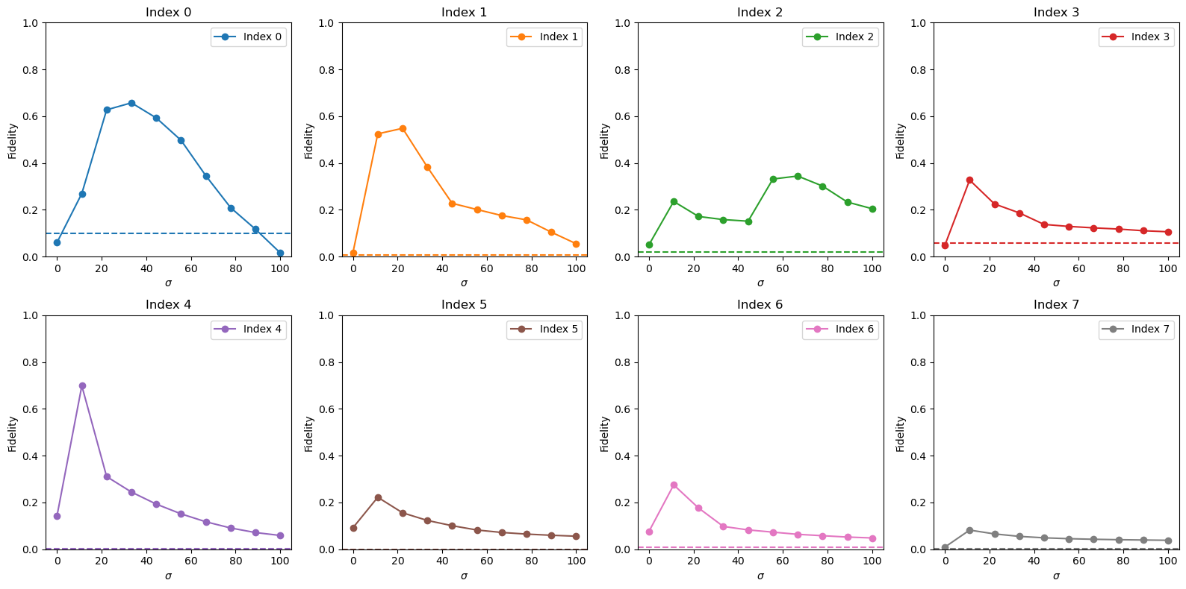
2. Denoising
2.A. Correcting Affine Distortions and Background Noise
A filter with $σ≈15$ tends to work better for all the measurements

Slide 19
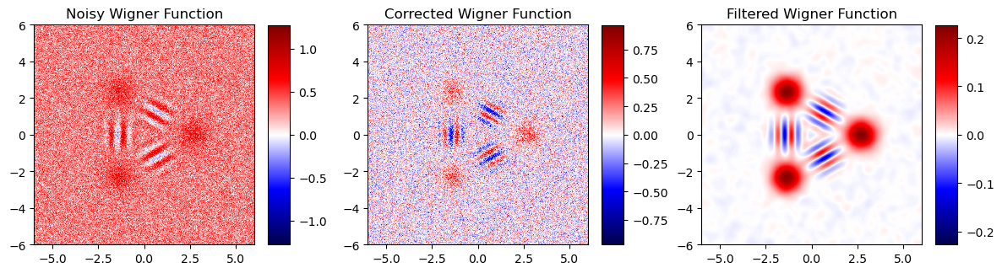
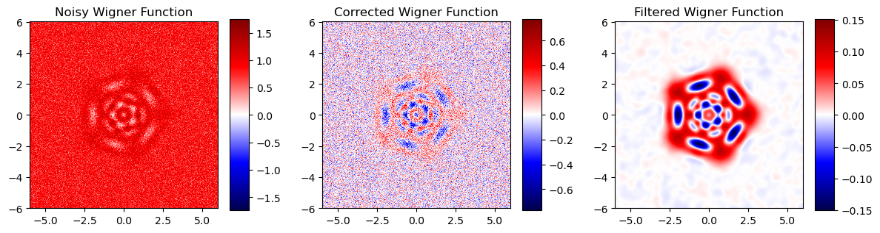
2. Denoising
2.A. Fixing $σ=15$ for the other values

Slide 20
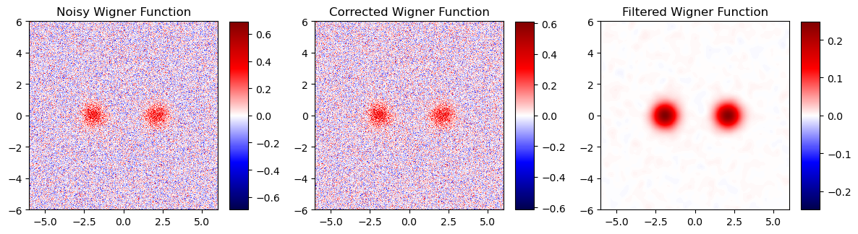
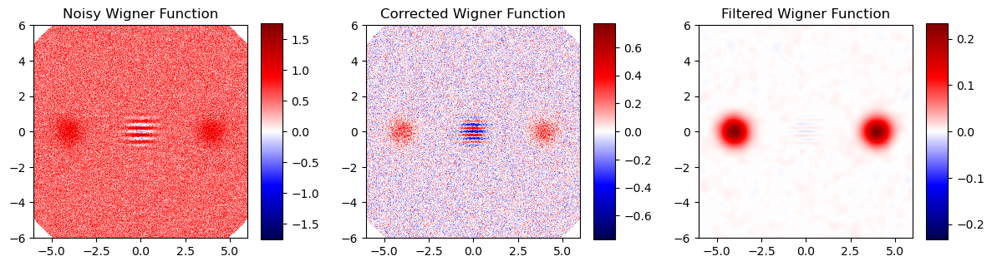
2. Denoising
2.A. Fixing $σ=15$ for the other values

Slide 21
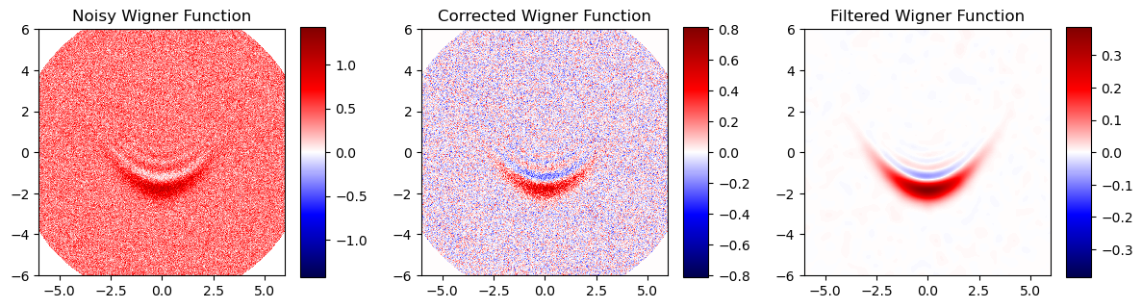
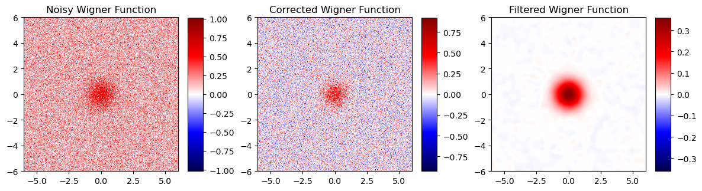
2. Denoising
2.A. Fixing $σ=15$ for the other values

Slide 22
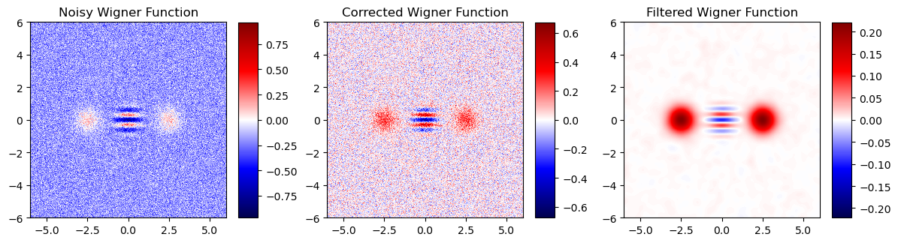
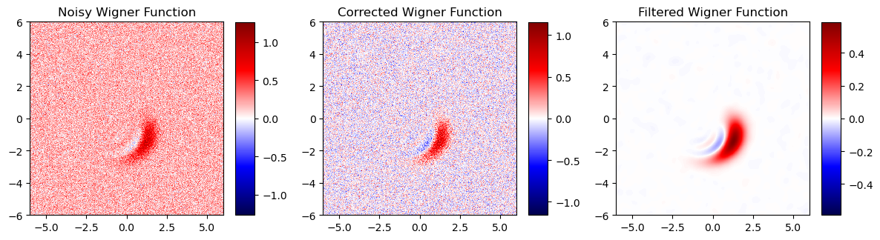
2. Denoising
2.A. Fixing $σ=15$ for the other values

Slide 23
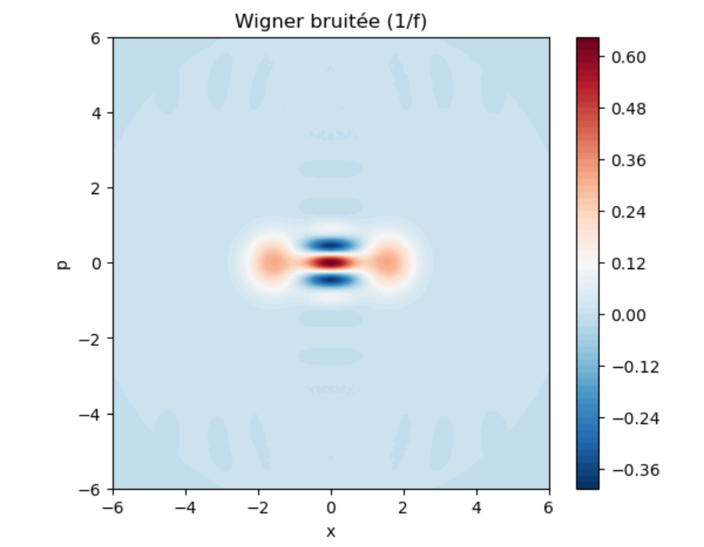
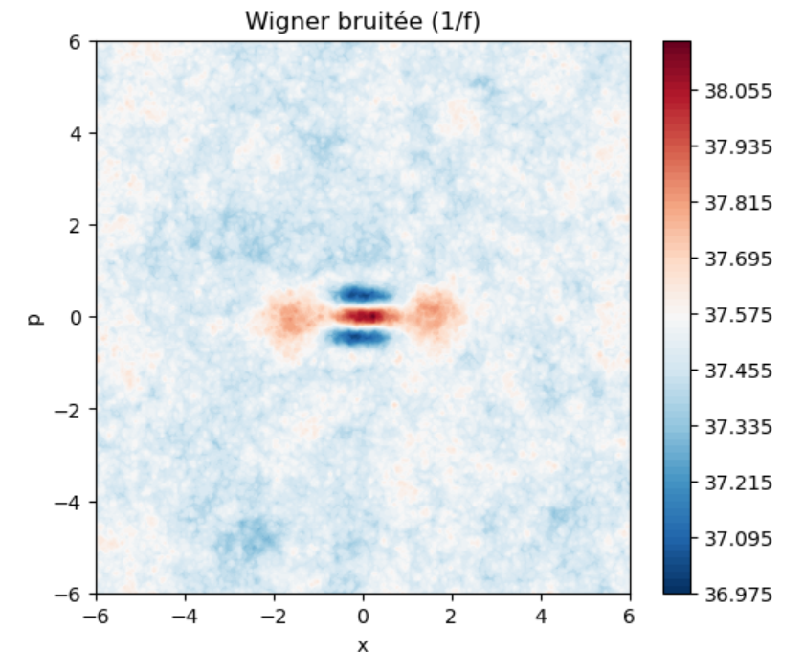
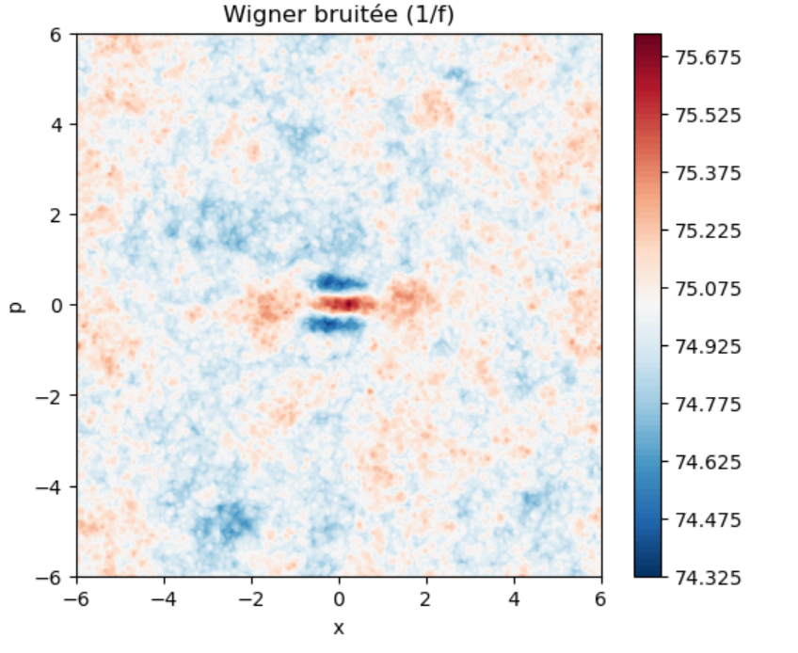
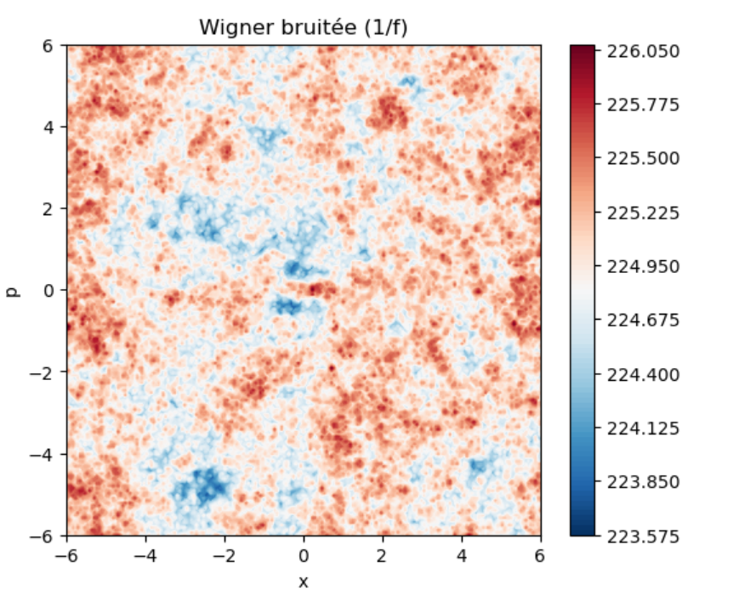
2. [OPTIONAL] Noise channels
Noise in superconducting qubits:
1/f noise, thermal noise

Slide 24
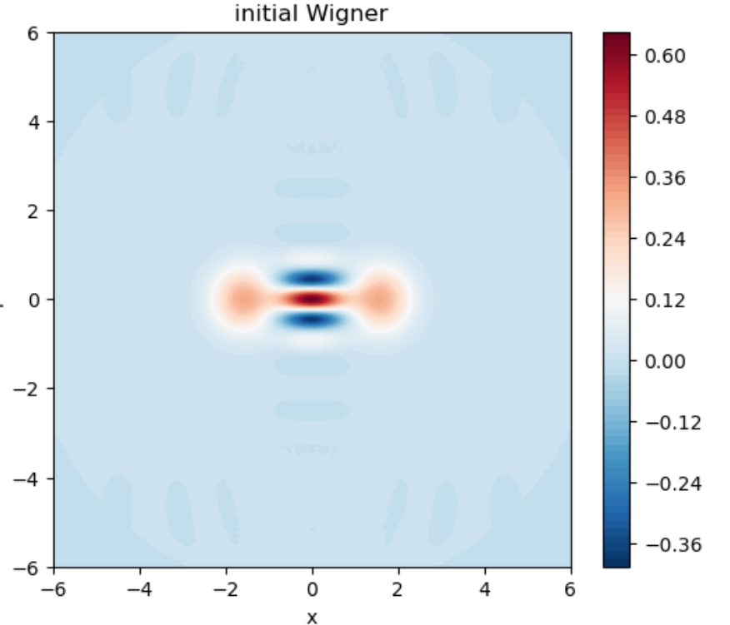
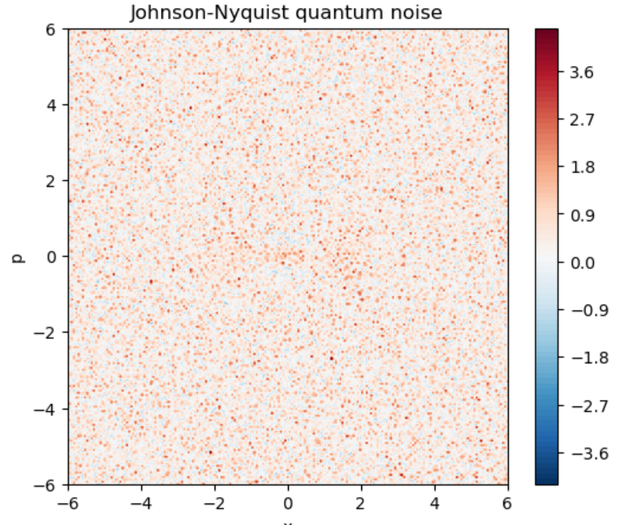
2. [OPTIONAL] Noise channels

Slide 25
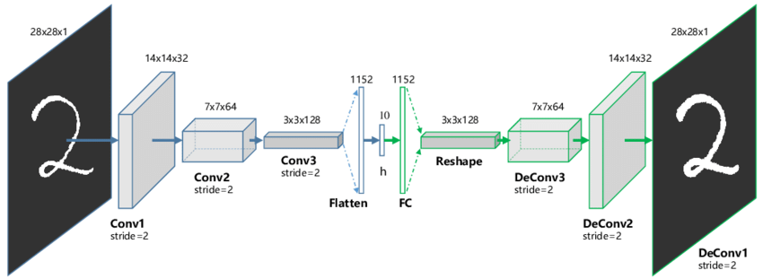
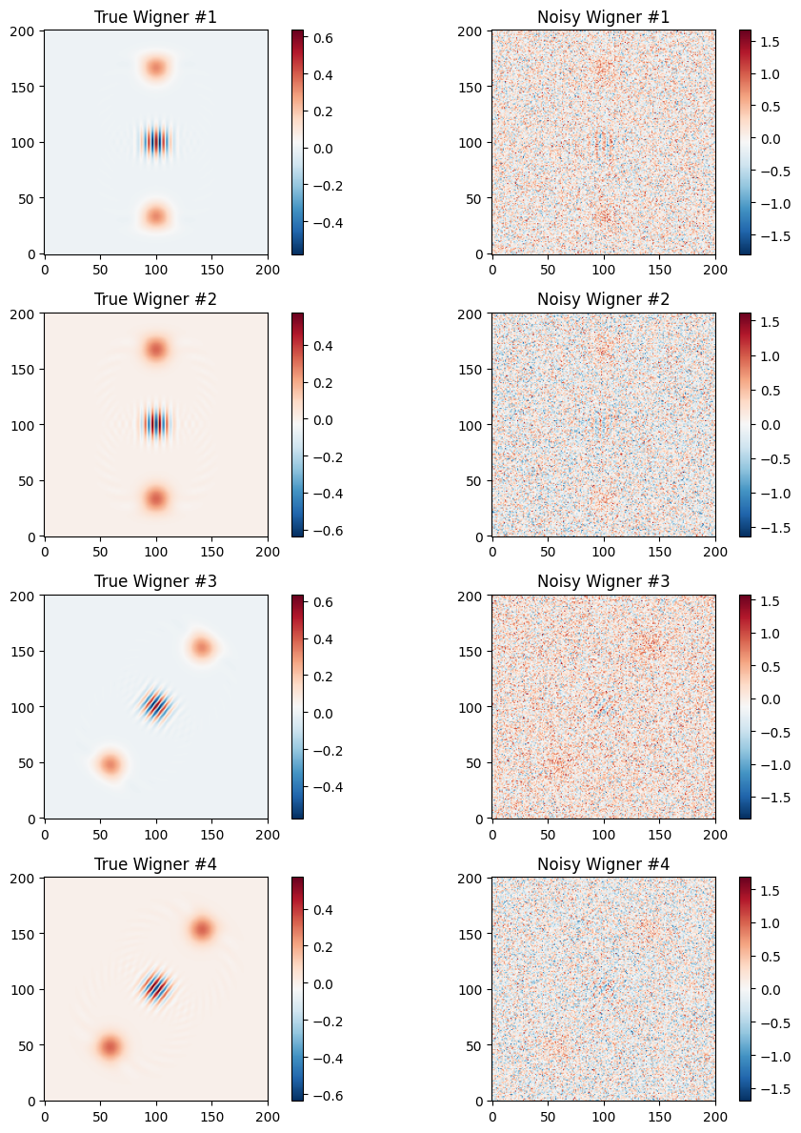
2. [OPTIONAL] Denoising with CNNAutoencoders
Input data
Target data

Slide 26
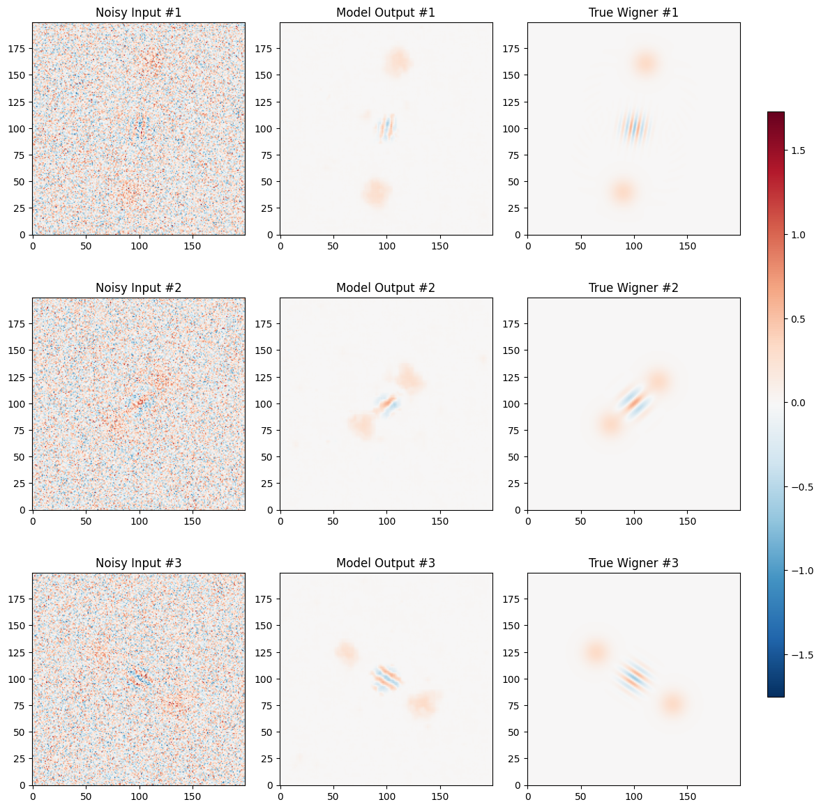
2. [OPTIONAL] Denoising with CNNAutoencoders
Results on validation set

Slide 28
